Slide 1
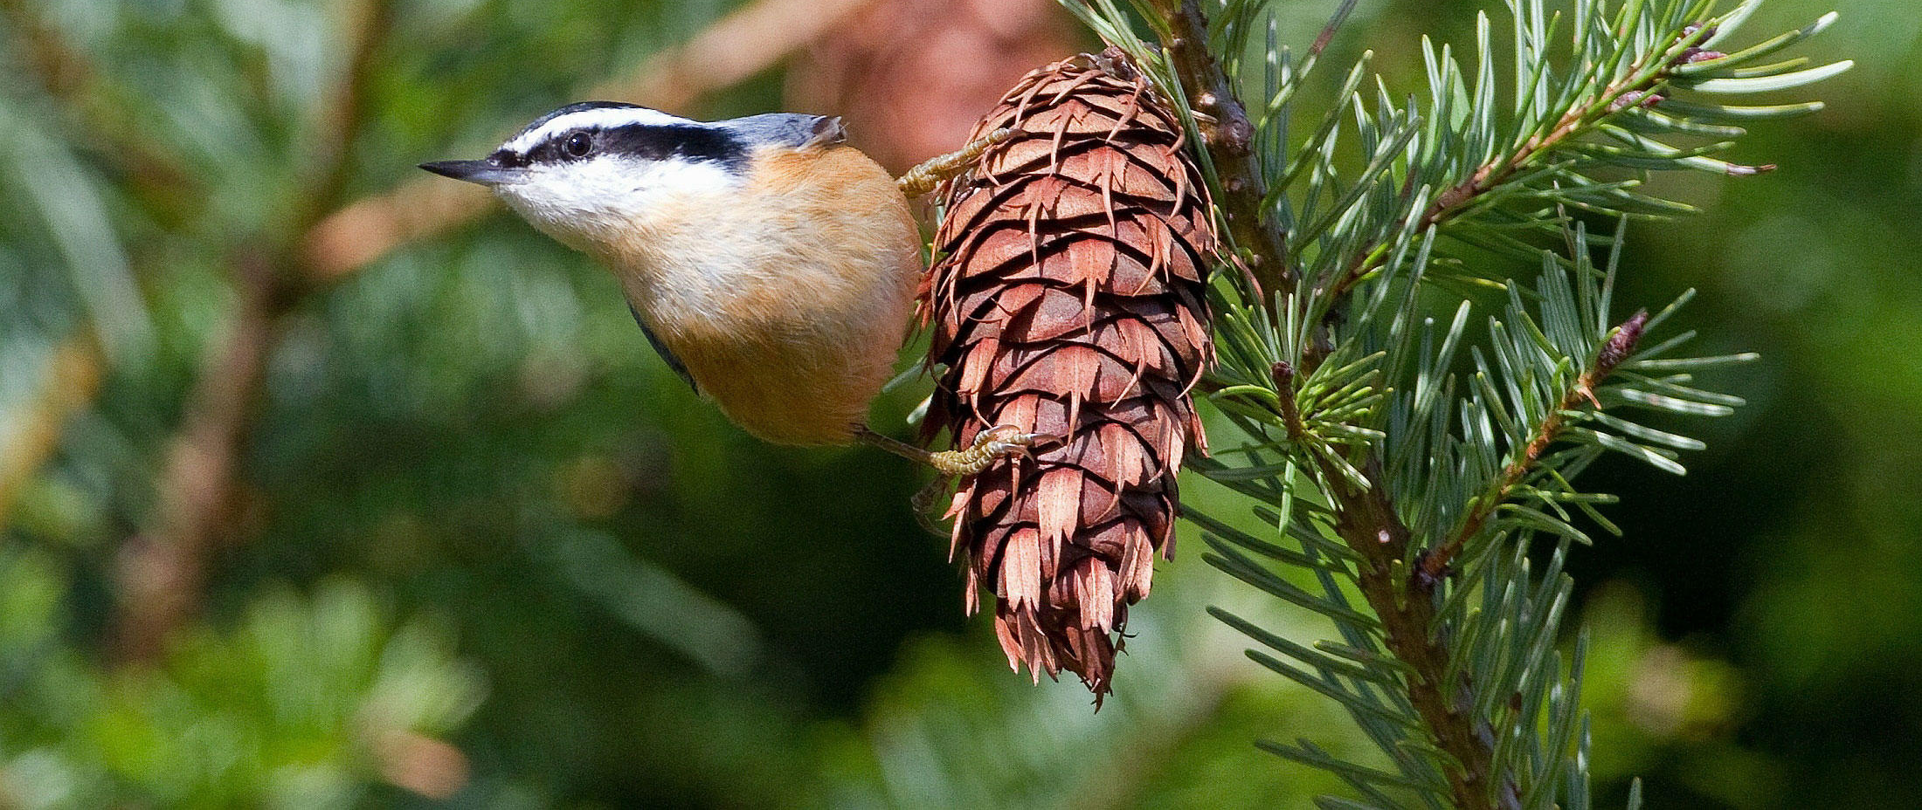

A flexible and efficient modeling strategy for trend analysis of North American Christmas Bird Counts
L. Miller
Timothy D. Meehan, Nicole L. Michel, Håvard Rue

Slide 2
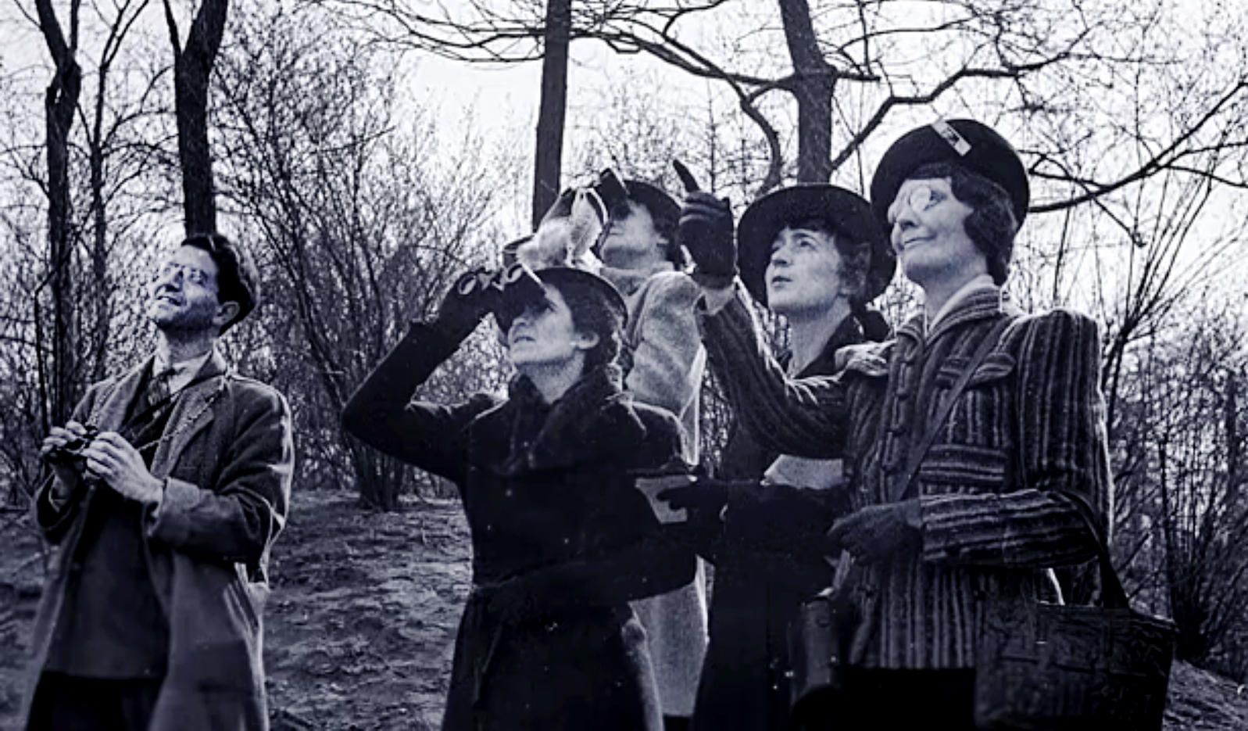
1900 Christmas Bird Count
27 volunteers
25 count circles
18,500 birds counted
89 species recorded
2 Countries
NAS Digital Archives
Notes:
1. Describe the first Christmas Bird Count in 1900.

Slide 3
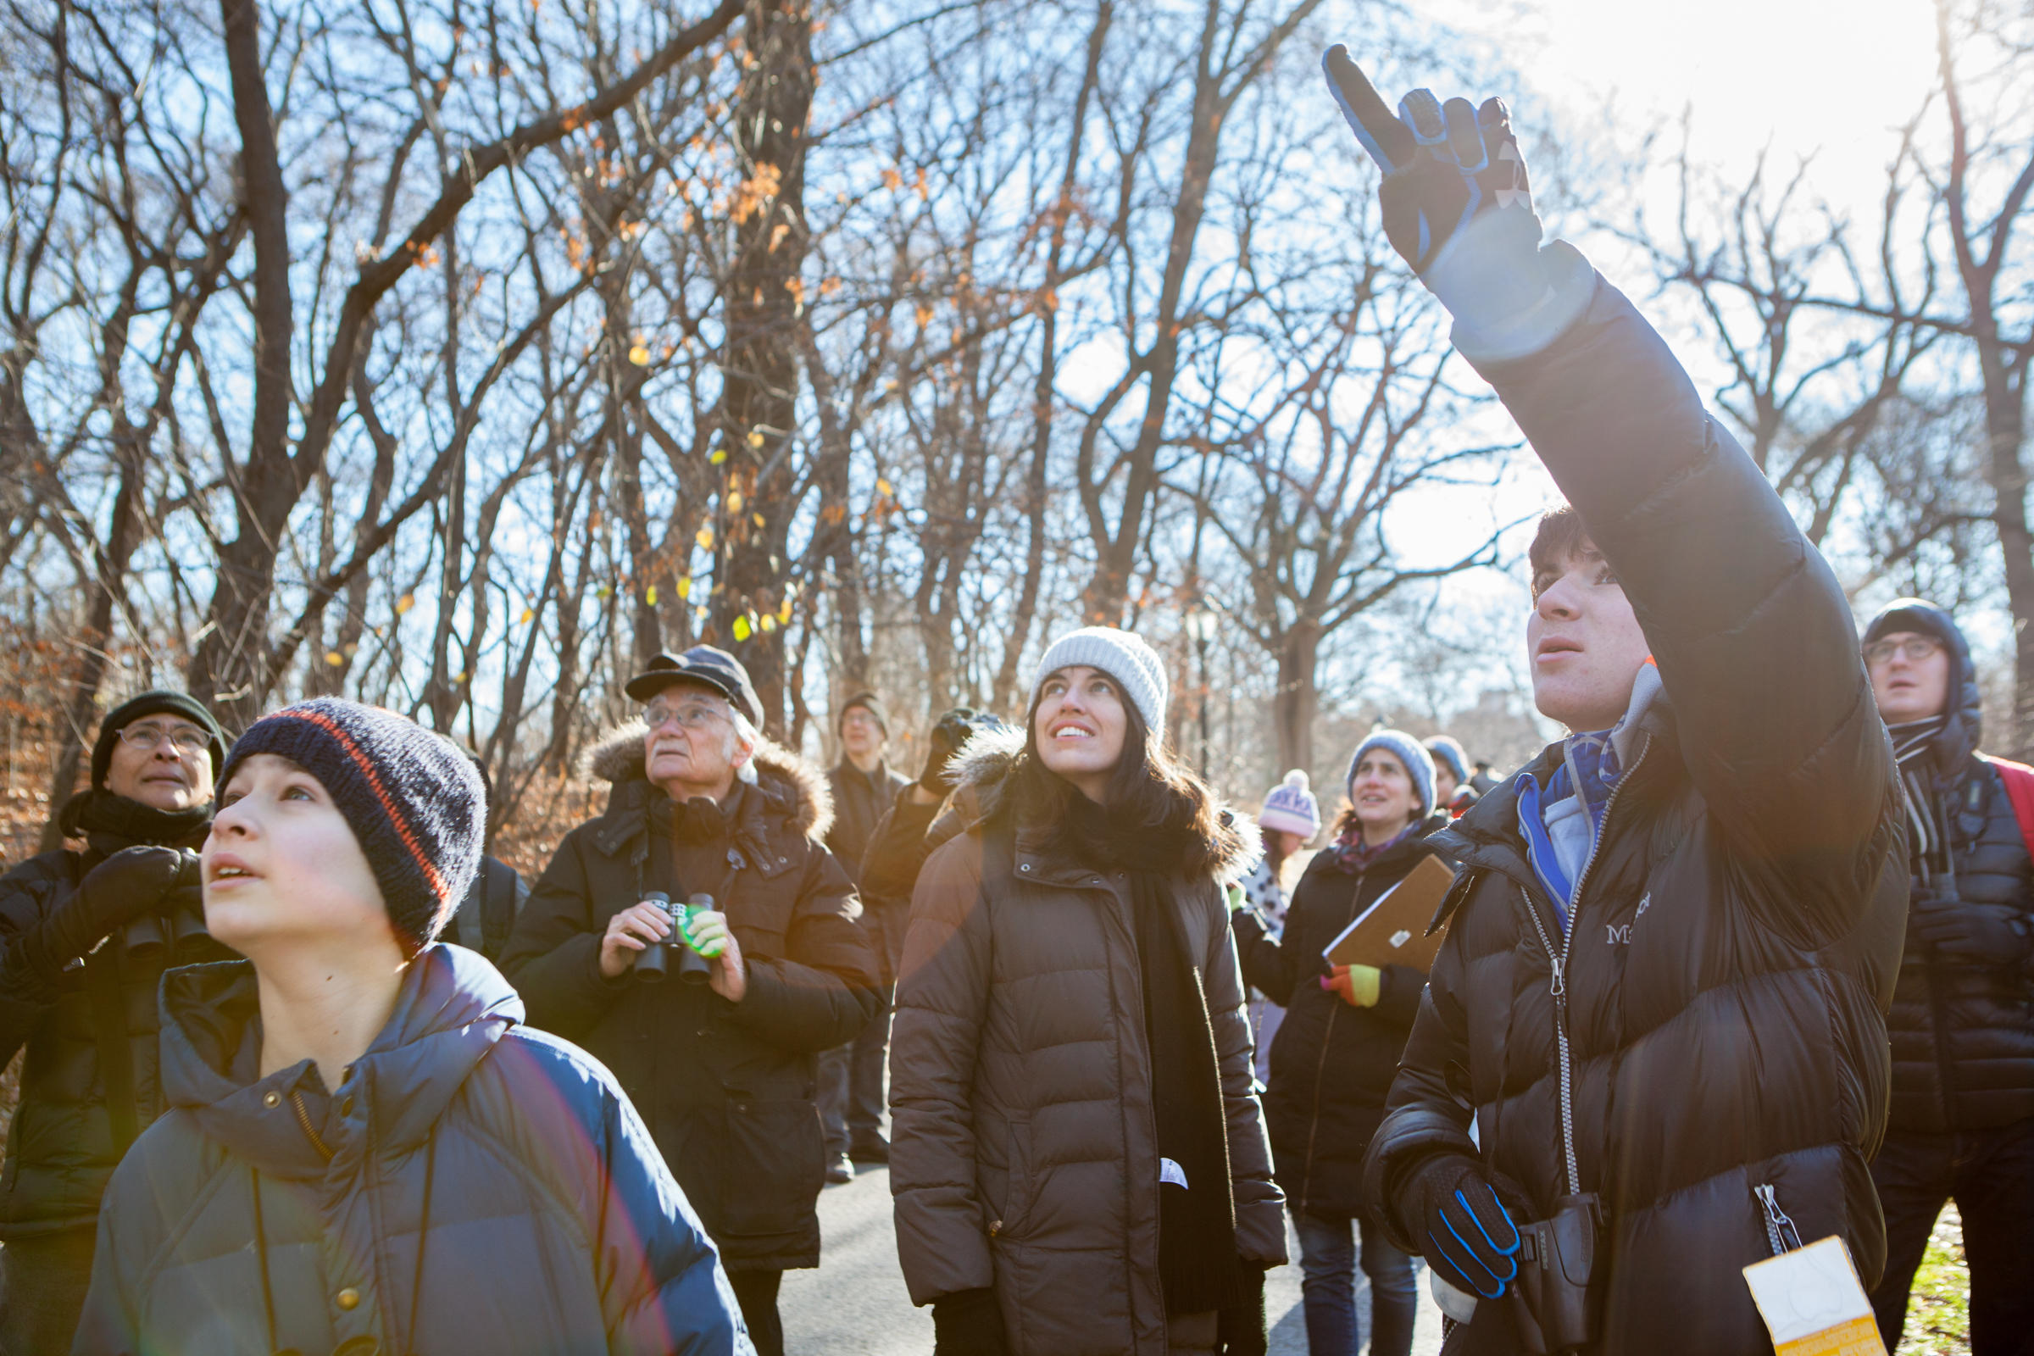
2017 Christmas Bird Count
73,153 volunteers
2,536 count circles
56,139,812 birds counted
2,636 species recorded
Across North and South America, Caribbean, Pacific Islands
NAS Digital Archives
Notes:
1. Describe what the CBC has become.

Slide 4
CBC Trends and Conservation
Count trends
1966-2017
550 species
Partners in Flight
North American Bird Conservation Initiative
NABCI
Notes:
1. We now produce long term trends for hundreds of species.
2. These trends are used to understand conservation status of North American birds.
3. They are especially useful for northern species who aren’t well sampled on breeding grounds.

Slide 5
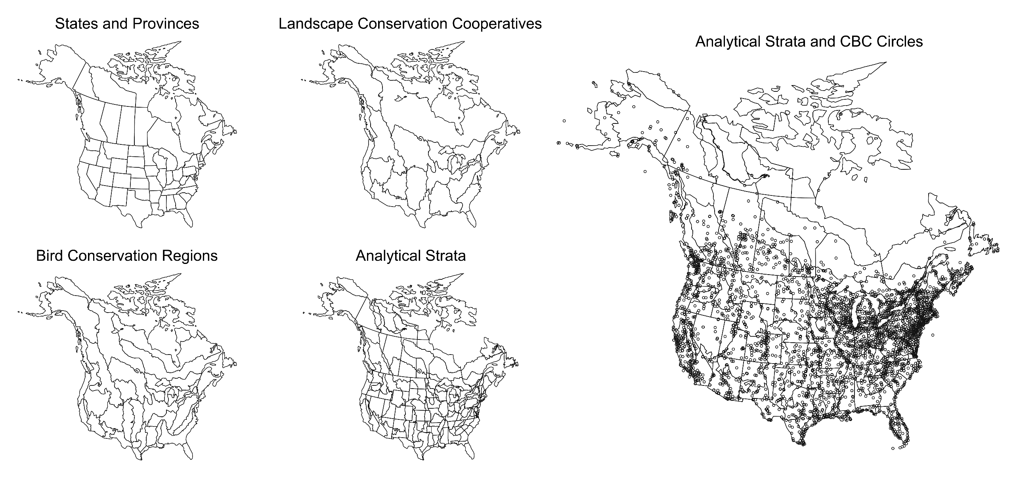
Standard Approach: Independent Strata
Notes:
1. The standard approach, modeled after analysis of the North American Breeding Bird Survey, bins counts into independent analytical strata that are intersections between states, provinces, and Bird Conservation Regions.

Slide 6
Standard Approach: Stratum Index Model
1. Intercept per stratum
3. Log-linear year effect per stratum
6. Overdispersion
5. Circle random effect
4. Stratum by year residual
2. Effort effect per stratum
Soykan et al. 2016
Notes:
1. Counts are modeled as described.

Slide 7
Standard Approach: Stratum Index
3. Stratum by year residual
4. Area and occurrence scaling
2. Log-linear year effect per stratum
1. Intercept per stratum
Soykan et al. 2016
Notes:
1. Parameter estimates are used to create a derived Abundance Index per stratum and year during MCMC simulations.

Slide 8
Standard Approach: Stratum Index Trend
Soykan et al. 2016
Notes:
1. Then Abundance Indices are used to derive a change or Trend in Abundance Indices per strata.

Slide 9
Different Approach: SVC Trend Model
Fine resolution
ICAR random intercepts
ICAR random slope for effort (SVC)
ICAR random slope for year (SVC)
Annual indices not a focus
R-INLA implementation
SVC strata
Notes:
1. The standard approach works great. But it doesn’t take account or advantage of the enormous amount of spatial structure in the data.
2. Also, people sometimes ask for finer scaled trend estimates, but this is not possible unless we build spatial models that share information across neighboring strata.
3. Thogmartin, Bled, Smith and others have experimented with CAR-structured random intercepts to generate Abundance Indices before deriving BBS Trends.
4. Here we experiment with CAR-structured random effort and year slopes.
5. Spatially structured random slope terms are components of Spatially Varying Coefficient (SVC) model.
6. Analyze Bayesian models with R-INLA instead of MCMC.

Slide 10
Different Approach: SVC Trend Model
1. Global and
CAR-random abundance index for reference year
3. Global and CAR-random year slope (SVC)
2. Global and CAR-random effort slope (SVC)
4. Exchangeable random circle effect
Notes:
1. First three terms are composite terms, each with a global and random effect.
2. Alpha is abundance index during reference year (2017) with global intercept and CAR random intercept.
3. Epsilon has global effect of effort and CAR random effect of effort.
4. Tau has global effect of year and CAR random effect of year.
5. Kappa is unstructured random effect of circle.
6. Not an explicit overdispersion effect, but using negative binomial distribution (Poisson with log-gamma random effect)
7. Cell by year term could be included, for computing annual indices, but is not here.

Slide 11
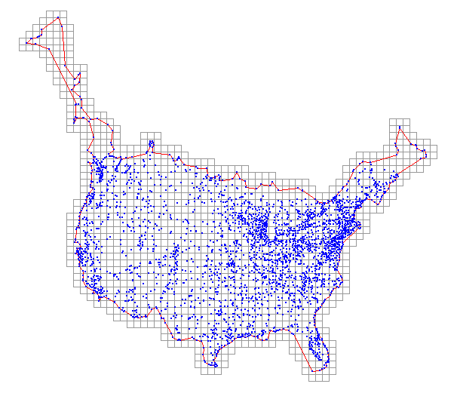

Example: American Robin
79,038 records 3195 locations 52 years
Notes:
1. Demonstration with American Robin counts from 1966-2017.
2. 79,038 observations, from 3195 count circles, over 52 years.
3. Overlay counts on 100 km grid.
4. On average, 2.3 circles per cell.
5. Counts are very much clumped.

Slide 12
Example: Computing with R-INLA
Model statement
formula <- count ~ 1 + f(grid_id1, model="besag", graph=g) + log_hrs +
f(grid_id2, log_hrs, model="besag", graph=g) + std_yr + f(grid_id3, std_yr,
model="besag", graph=g) + f(circle, model="iid“)
Function call
result <- inla(formula, family="nbinomial", data=modeling_data,
control.compute=list(cpo=T, config=T))
Notes:
1. This is how the model is specified in R-INLA.
2. This is how the inla() function is called. Note that CPO and PIT are available for model fit and selection.

Slide 13
Example: Computing with R-INLA
Time used: 4.70 hr
Fixed effect: 0.025quant 0.5quant 0.975quant
Global intercept 0.602 0.772 0.941
Global log_hrs effect 0.774 0.815 0.857
Global std_yr effect 0.022 0.025 0.027
Hyperparameter: 0.025quant 0.5quant 0.975quant
1/Overdispersion 0.444 0.449 0.453
Precision alpha CAR 0.673 0.688 0.703
Precision epsilon CAR 33.055 33.691 34.340
Precision tau CAR 678.391 707.756 738.433
Precision kappa iid 0.927 0.969 1.012
Notes:
1. Note non-linear effort effect.
2. Note overall increase in Robins. 3. Note overdispersion (2.25).
4. Note significance of spatial structure.
5. INLA is much quicker than MCMC, 5 versus 15 hours, even with all the spatial terms added.

Slide 14
Alpha: 2017 Abundance Indices
Notes:
1. Alpha scaled to 100 party hours.
2. Robins like it mild.

Slide 15
Epsilon: Effort Effects
Notes:
1. Effort effect ranges from linear to asymptotic.

Slide 16
Tau: Year Effects
All cells with counts
Significant cells
Notes:
1. Negative trends in the south and positive in the north indicate winter range shift, possibly due to backyard feeders and climate change.
2. Robins are keeping it mild.
2. Less uncertainty where there is more information.

Slide 17
Aggregation: BCR Trend Estimates Compared
SVC
Standard
Notes:
1. Trends aggregated to Bird Conservation regions. Different methods have similar posterior medians.

Slide 18
Aggregation: BCR Trend Estimates Compared
Spearman’s r = 0.88
SVC tau (% per year)
Notes:
1. Trends aggregated to Bird Conservation regions. Different methods have similar posterior medians.

Slide 19
Aggregation: BCR Trend Precision Compared
Notes:
1. Precision of SVC estimates within a BCR range from relatively small to relatively large, depending on how much information is available in the BCR.

Slide 20
Aggregation: BCR Trend Precision Compared
SVC
Standard
Notes:
1. Which approach to estimating uncertainty is more appropriate?

Slide 21
Take Aways: SVC Trend Model with R-INLA
Fine resolution results are possible when modeling spatial structure.
With spatially-structured random slopes (SVC), trends are part of model and they vary spatially.
Spatially-explicit estimates of trend uncertainty become possible.
Aggregate trends (BCR) are similar in magnitude and precision.
Cell by year term is possible for creating annual indices.
With R-INLA, code is clean and analysis is fast.
Notes:
1. Take aways.

